Slide 1
EMPLOYEE DATA ANALYSIS USING EXCEL
Employee
Data Analysis
Using Excel
STUDENT NAME: ROOBASRI.M
REGISTER NO:122204034
DEPARTMENT: B.COM (CORPORATE SECRETARYSHIP)
COLLEGE:SHRI KRISHNASWAMY COLLEGE FOR WOMEN

Slide 2

PROJECT TITLE
EMPLOYEE GENDER ANALYSIS USING EXCEL

Slide 3
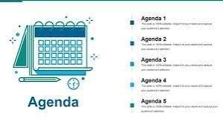
AGENDA
1.problem statement
2.project overview
3.end users
4.our solution and preposition
5.data set description
6.Modelling approach
7.results and discussion
8.conclusion

Slide 4
PROBLEM STATEMENT
As an HR analyst, you have been tasked with conducting a conducting comprehensive gender analysis of the organization workforce . The goal is to understand the current gender distribution, identify potential gender disparities, and inform diversity and inclusion initiatives.
OBJECTIVES
1.calculate the overall gender distribution across different departments, job little, and locations.
2.Analyze the gender under representative gender groups in various areas of a organization.
3.Identify under representative gender groups in various of the organization

Slide 5
PROJECT OVERVIEW
Objective: To conduct a comprehensive analysis of the organization’s workforce to understand the current gender distribution, identify potential gender disparities, and inform diversity and inclusion initiatives
Scope: - Analyse employee data across various dimensions (department, job title, location) - Calculate gender ratios and percentages Deliverables:
Comprehensive report summarizing the analysis 2. Excel worksheets with pivot tables, charts, and graphs
Timeline: - Data collection and preparation: 2 days - Analysis and visualization days

Slide 6
WHO ARE THE END USERS?
1. HR Leadership: To inform strategic decisions on diversity, equity, and inclusion initiatives. 2. Diversity and Inclusion Team: To develop targeted programs and interventions addressing gender disparities. 3. Department Heads: To understand gender distribution within their teams and identify areas for improvement. 4. Employee Resource Groups (ERGS): To support gender-specific initiatives and advocate for change. 5. Senior Management: To provide insights for decision-making on talent development, succession planning, and organizational culture

Slide 7
OUR SOLUTION AND ITS VALUE PREPOSITION
1. Enhance Diversity and Inclusion: Identify and address gender disparities, fostering a more inclusive workplace culture. 2. Improve Talent Management: Develop targeted initiatives to attract, retain, and promote top talent from underrepresented gender groups. 3. Boost Employee Engagement: Create a more equitable work environment, leading to increased employee satisfaction and productivity. 4. Support Business Objectives: Drive business success by leveraging diverse perspectives, improving decision-making, and enhancing reputation. 5. Meet Regulatory Requirements: Ensure compliance with equal employment opportunity laves and regulations.

Slide 8
DATA SET DESCRIPTION
1. Employee ID: Unique identifier for each employee 2. “Gender*: Employee’s self-identified gender (Male, Female, Non-binary, Prefer not to disclose) 3. *Department*: Employee’s department or team 4. Job Title: Employee’s job title or position 5. *Location*: Employee’s work location (city, state, country) 6. *Job Level*: Employee’s job level or grade 7. *Hire Date*: Employee’s hire date 8. *Tenure*: Employee’s tenure with the organization (in years) 9. *Full-time/Part-time*: Employee’s work status (Full-time, Part-time) 10. “Manager ID*: Employee’s manager or supervisor

Slide 9
W-Wide-ranging Insights: Our solution provides a comprehensive analysis of gender distribution across various dimensions, including department, job title, location, and job level. O-Objective Recommendations: We offer data-driven, actionable recommendations to address gender disparities, ensuring Objective decision-making. V-Workplace Transformation: Our solution empowers organizations to create a more inclusive workplace culture, driving business success and employee satisfaction

Slide 10
MODELLING
1. Descriptive Analytics: - Gender distribution across departments, job titles, locations, and job levels - Identification of underrepresented gender groups 2. Inferential Analytics: - Statistical analysis to identify significant differences in gender representation Hypothesis testing to determine if differences are due to chance or underlying factors 3. Predictive Analytics: - Modelling to forecast future gender distribution based on trends and patterns - Identification of potential barriers to gender parity 4. Prescriptive Analytics: - Development of targeted initiatives to address gender disparities - Recommendations for diversity and inclusion strategies

Slide 11
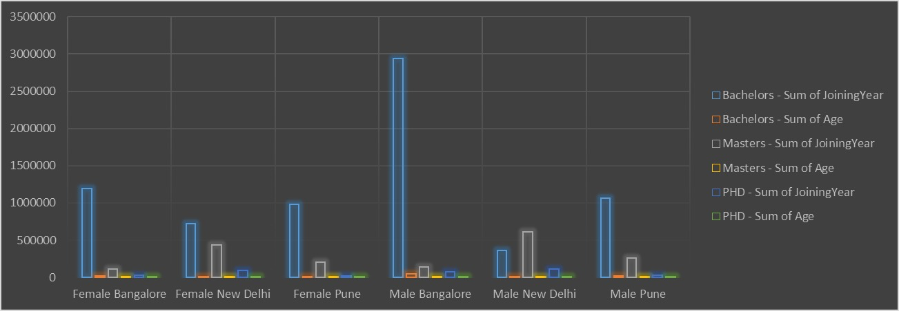

Slide 12
CONCLUSION
The employee Gender analysis has provided valuable insight into the current state of gender diversifying the organization. The findings highlight areas of strength and weakness ,identifying opportunities to improve gender representation address disparities.

